Slide 1
Data:
Distribution of depression labels among each patient/individual
Overlapping of sleep labels
Feature extraction:
Spectral envelope and optimal scaling (Li et al 2021)
Classifier:
Gaussian processes?

Slide 2
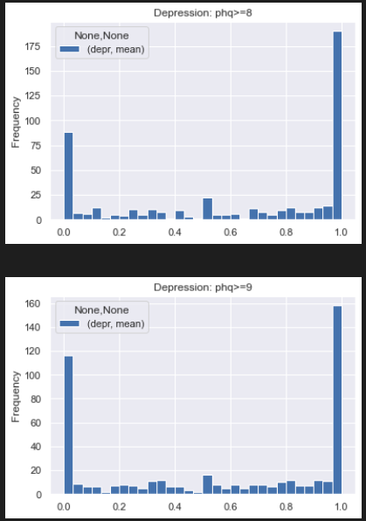
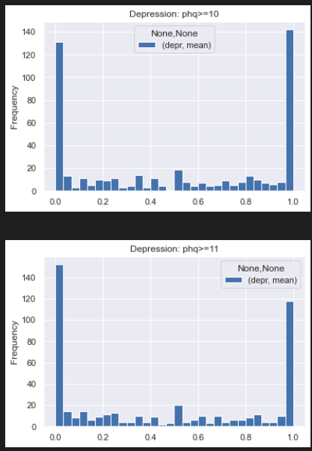
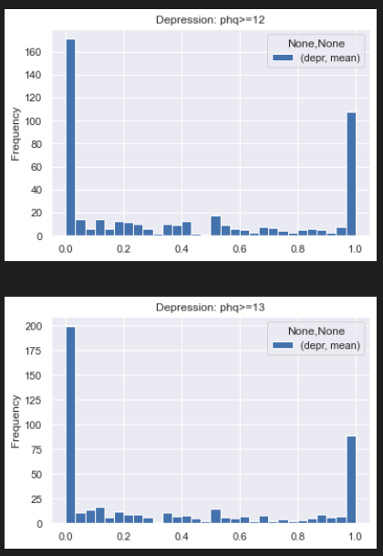

Slide 3
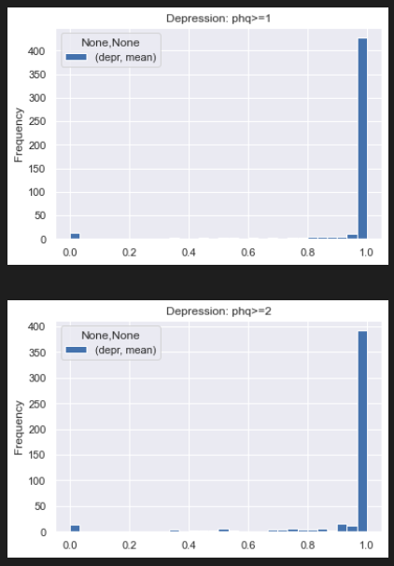
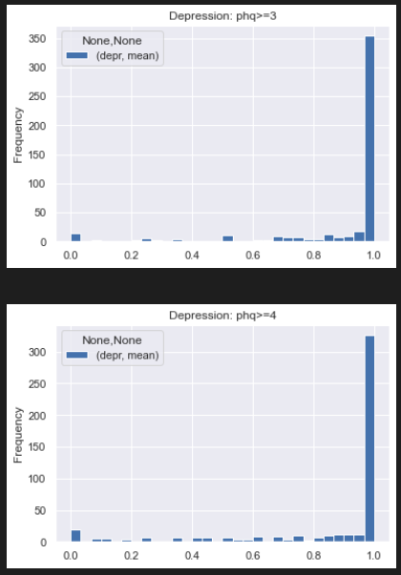
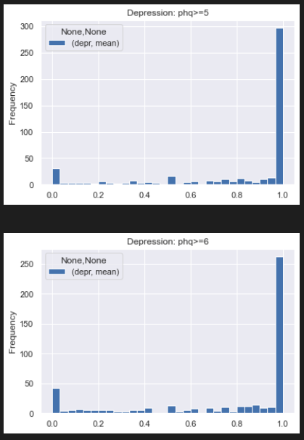
1-6

Slide 4
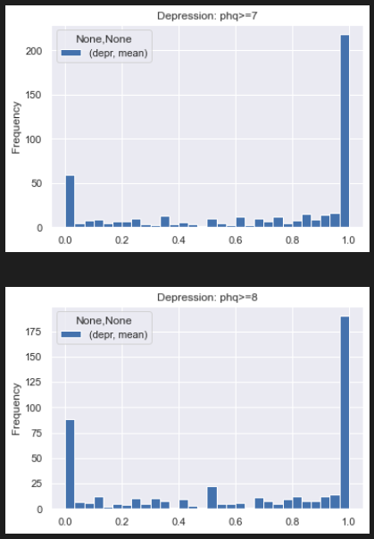
7-8

Slide 5
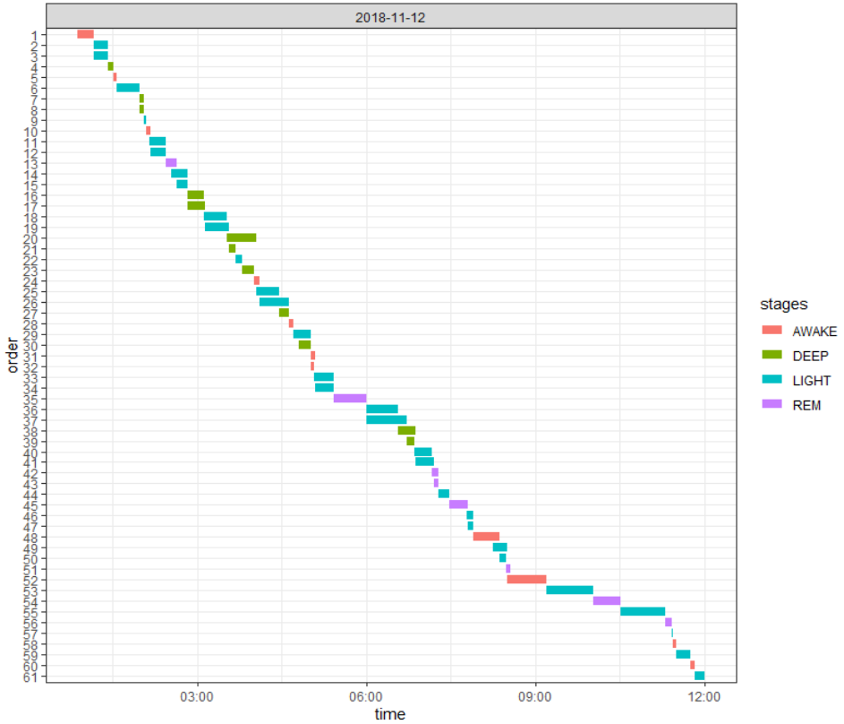
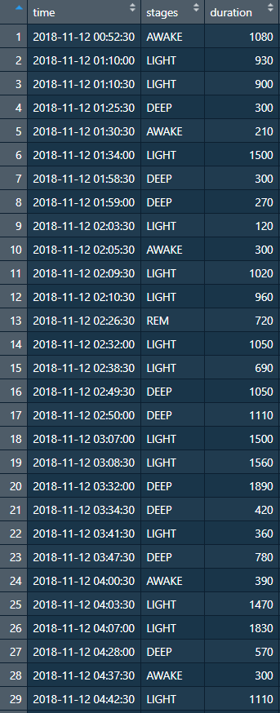
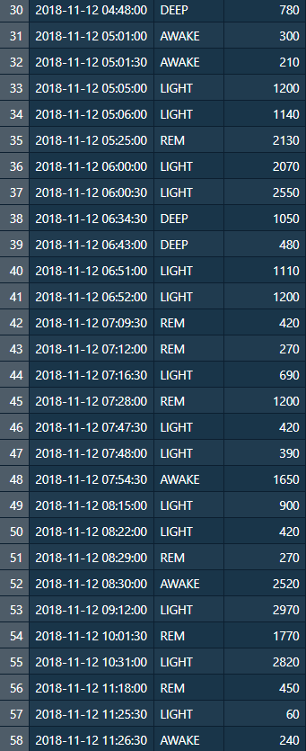
PID: 3c6671b8-45ae-4552-b92b-934ec6bbb89f

Slide 6
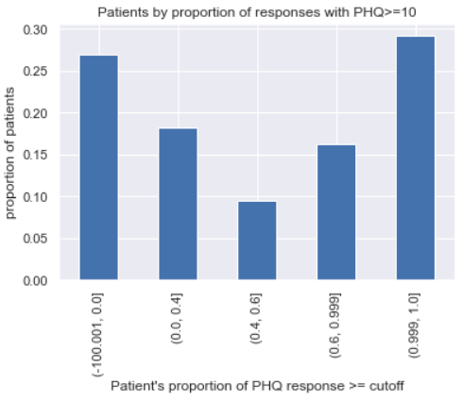
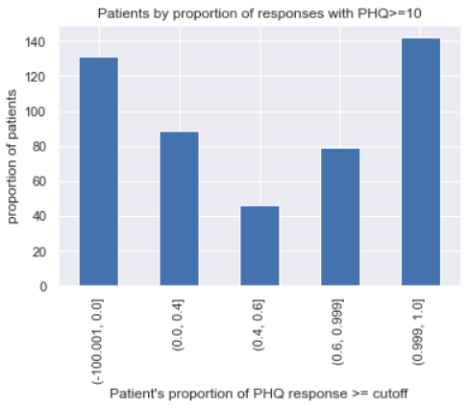

Slide 7
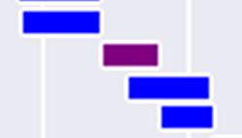
Less 0.5% of measured timestamps have >1 (duplicated) label
Only 122 out of 461 subjects have duplication issue
Depth =
1
2
2

Slide 8
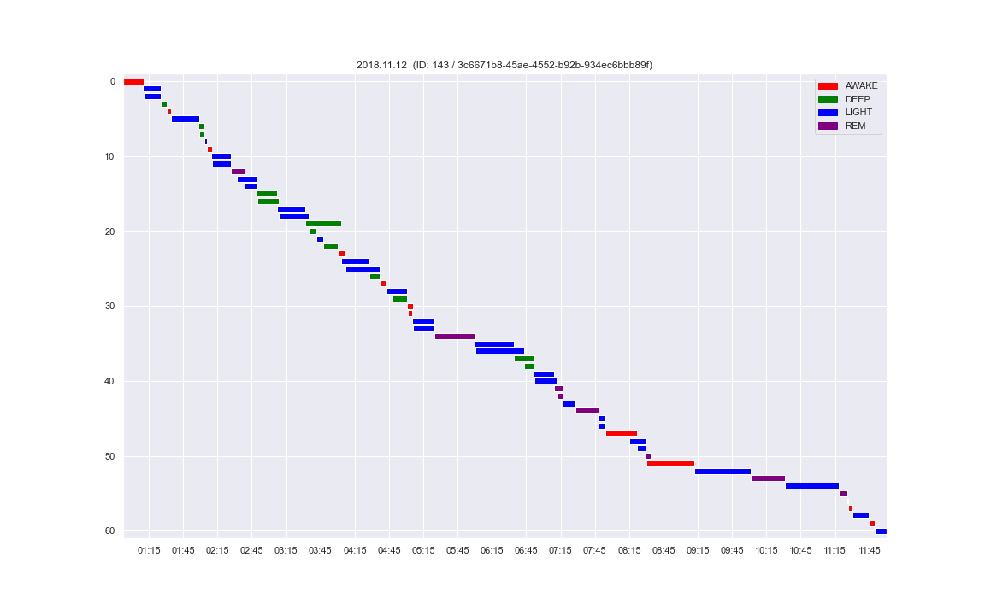
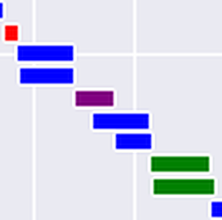
Before dedup

Slide 9
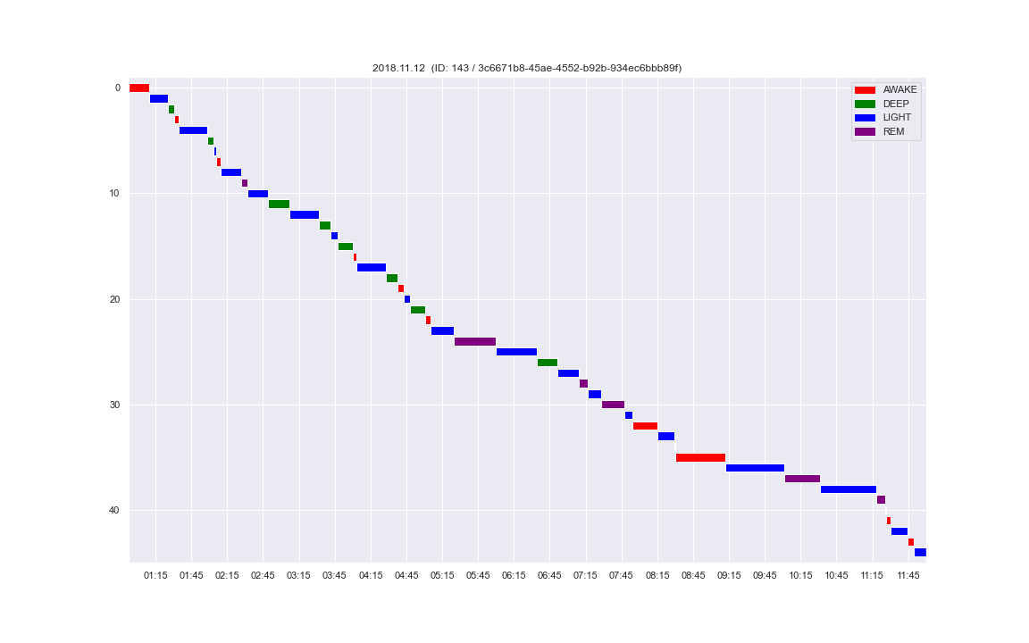
After dedup

Slide 10
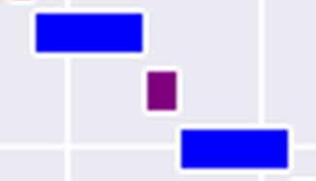
Hard-to-resolve situations
→`
→
→
Before dedup
After dedup

Slide 11
Other issues
Patient IDs in PHQ and sleep stages – some are non-existent in meta-data file

Slide 12
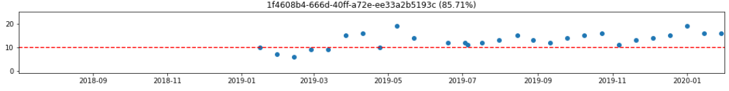
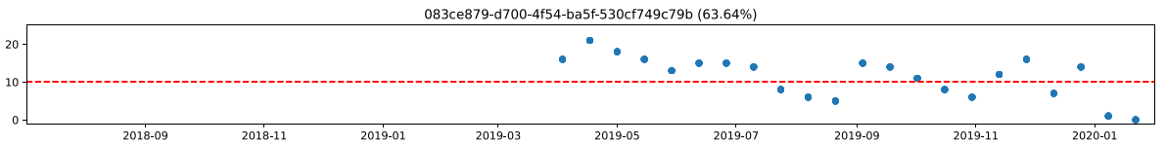
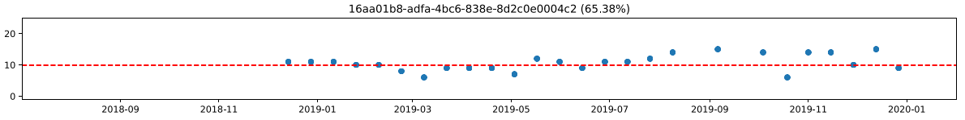
PHQ trajectories
Duplicate records
High/low variability in trajectories
MSc Project • 2022.02.10 updates

Slide 13
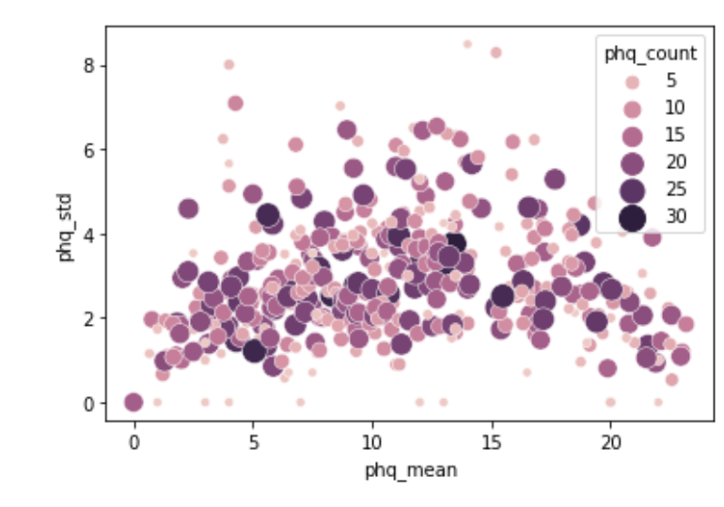
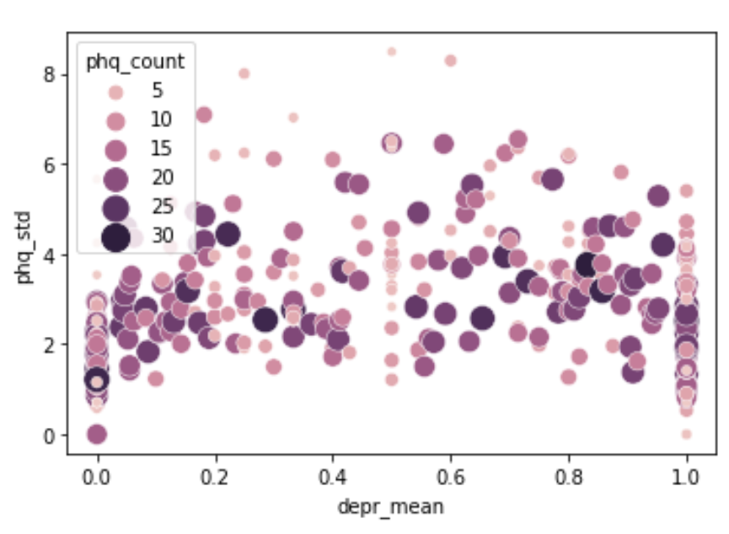

Slide 14
Outlook
Match by date
Run simple logistic model
Run empty mixed model vs non-mixed model
MSc Project • 2022.02.10 updates

Slide 15
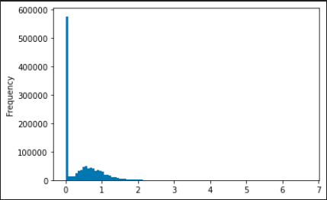
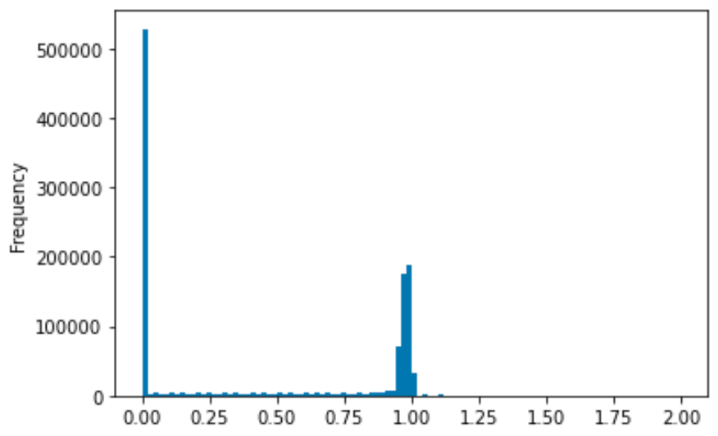
Preprocessing
Input dataframe: Each row = hour
Each column = proportion of sleep stage (awake/deep/light/rem)
Expected:
‘total’ sleep stage proportion per hour = 1
Accounting for missing values, 0 <= ‘total’ proportion <= 1
Problem: A significant number of hours (12.1%) show a ‘total’ proportion of >1
Many rows
Before: Distribution of hourly sleep stage proportions
After: Distribution of hourly sleep stage proportions
Total proportion=0 (entirely missing): 43.6%
MSc Project • 2022.03.02 updates

Slide 16
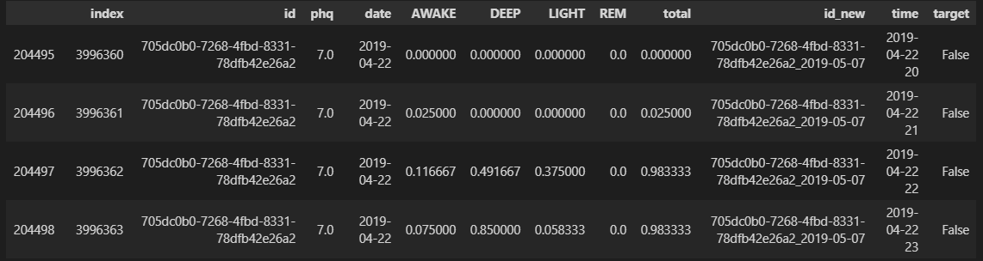
Preprocessing
Example input
MSc Project • 2022.03.02 updates

Slide 17
Preprocessing
Sleep stage intervals (n=1,855,957, 618,082 hours)
PHQ test records (n=5082)
Remove records from subjects unmatched in PHQ/metadata (n=57728, 3.11%)
Remove records from subjects unmatched in sleep data/metadata (n=233, 4.58%)
Sleep stage 30s timestamps (n=70,190,672)
PHQ test records (n=4849)
Remove timestamps outside 8pm-10am (n=2,932,777, 4.18%)
Deduplication (n=258,575, 0.38%)
Binning
Hourly-binned proportions (n=735555)
Merged
X (hourly proportions) Depressed: 414000 (56.28%) Non-depressed: 321555 (43.72%)
Target (PHQ test result covering 14-days) Depressed: 1725 (55.24%) Non-depressed: 2129 (44.76%)
MSc Project • 2022.03.02 updates

Slide 18
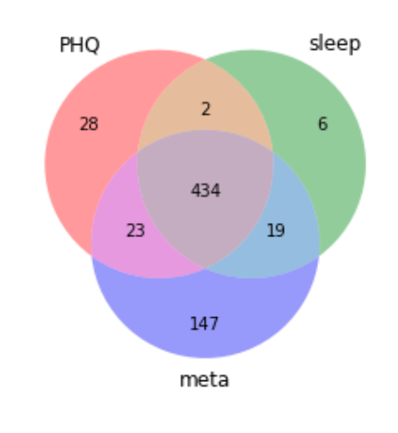
Preprocessing
Subject IDs in three data sources
MSc Project • 2022.03.02 updates

Slide 19
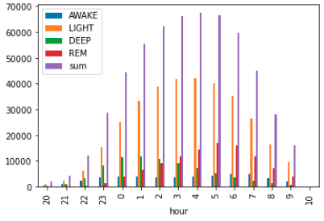
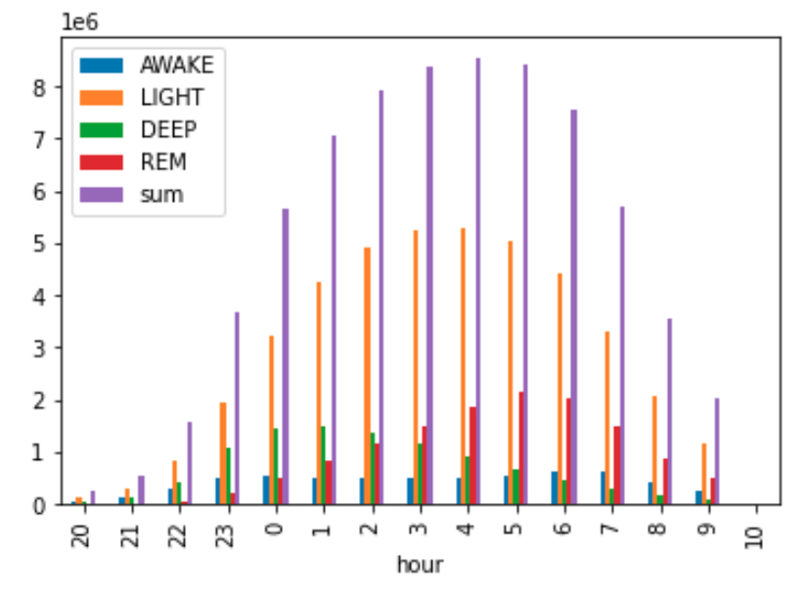
Preprocessing
Distribution of recorded sleep data by hour (8pm-10am)
MSc Project • 2022.03.02 updates

Slide 20
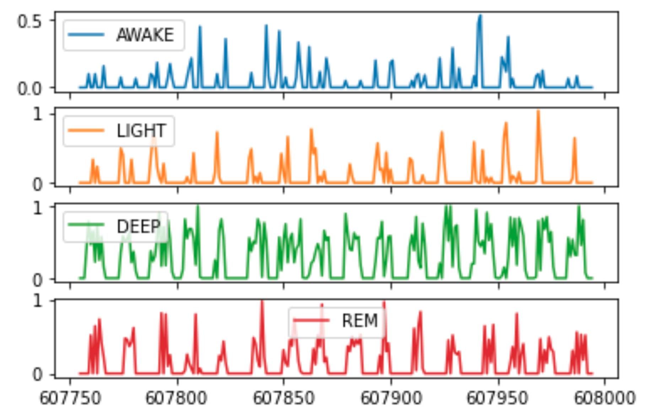
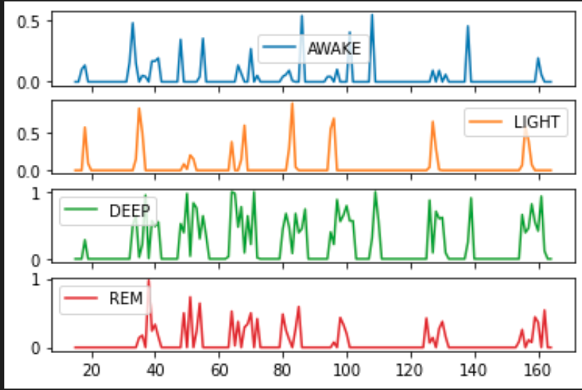
Feature extraction
Preview of input time series
Non-depressed
Depressed
show = df.loc[df['id_new']=='6fcdd023-6388-4650-a30d-8311015fc731_2019-05-08'] # non-depressed
show2 = df.loc[df['id_new']=='bf3defd7-2a52-4557-8202-9d887957e109_2019-02-04'] # depressed, same subject
MSc Project • 2022.03.02 updates

Slide 21
Title
Subtitle
- PCA and ICA taken jointly did not improve performance
- Feature transformation methods lower interpretability
- Different feature subsets give similar performance --> suggests the presence of different Markov Blankets
- i.e. "there may be different underlying combinations of features which essentially can jointly capture" the key characteristics for class separation”
Code
MSc Project • 2022.03.02 updates

Slide 22
Preprocessing
Current issues (fix later):
Probably dump 10am instead of keeping it
A few hours still have ‘total’ proportion > 1, reason unknown
RF classifier show terrible performance – need to double check preprocessing
Need to double check deduplication logic – is the code working as intended?
Code:
Routines
Bar plot with percentages
Anything else?
Understanding
pandas index
pandas datetime
MSc Project • 2022.03.02 updates

Slide 23
Pipeline
Baseline models
tsFresh
After filtering by non-missing days >= 12, number of deltaT = 2860
Feature Extraction: 3156 features
Feature Selection: 422 features
Train-test-split (not stratified by subject):
Training Features Shape: (858, 422)
Training Labels Shape: (858,)
Testing Features Shape: (2002, 422)
Testing Labels Shape: (2002,)
Testing proportion: 379 T – 479 F (44.1%)
Training proportion: 853 T – 1149 F (42.6%)
Preprocessing + Models + Tuning:
StandardScaling + KNN
StandardScaling + SVM classifier
No scaling + RandomForest
No scaling + LogisticRegression and regularized variants
MSc Project • 2022.03.24 updates

Slide 24
Tuning results on training set
Baseline models
### knn
Best score: 0.6361371153306452
Best params: {'knn__n_neighbors': 9}
### svc
Best score: 0.644029916331013
Best params: {'svc__C': 10, 'svc__gamma': 0.001, 'svc__kernel': 'rbf'}
### rf
Best score: 0.6363237836379443
Best params: {'rf__max_depth': 20, 'rf__max_features': 'auto', 'rf__min_samples_split': 2, 'rf__n_estimators': 200}
### logistic
Best score: 0.6189314284232641
Best params: {'logistic__C': 0.1, 'logistic__penalty': 'l1', 'logistic__solver': 'liblinear
MSc Project • 2022.03.24 updates

Slide 25
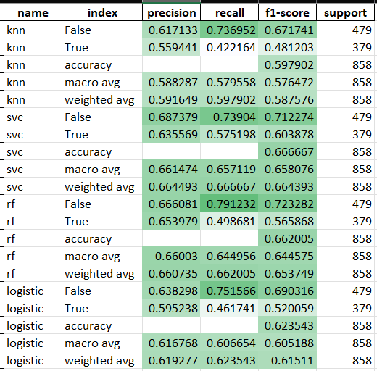
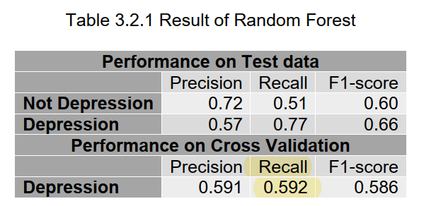
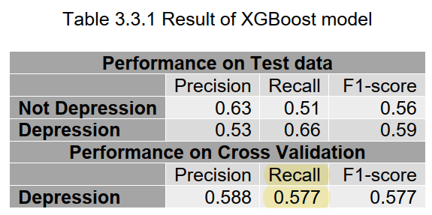
Performance on test set
Baseline models
MSc Project • 2022.03.24 updates

Slide 26
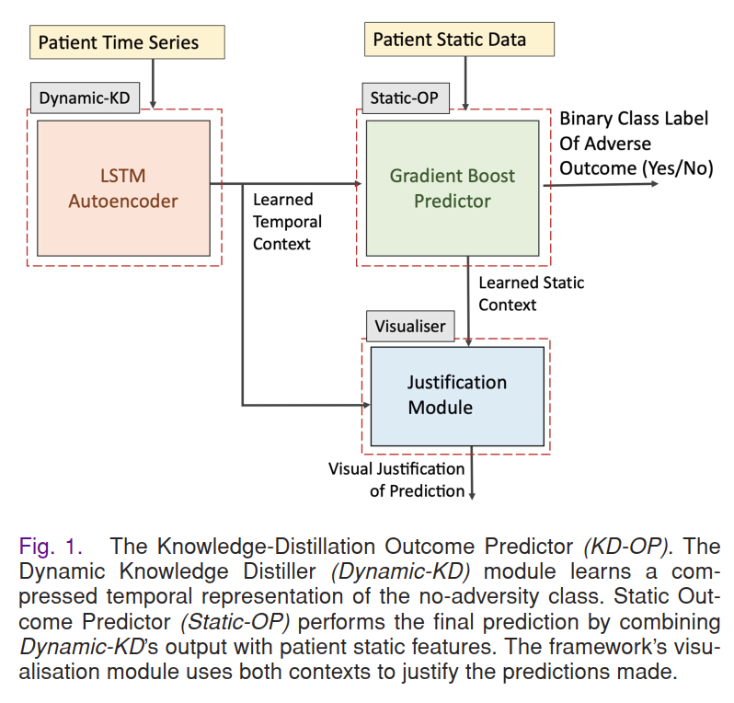
How to consider mixed effects?
Research idea
Time series
“Static” data
multiple levels to consider
Week level
Subject level
(3) ‘Stability’ of sleep? Standard deviations of some metrics?
MSc Project • 2022.03.24 updates

Slide 27
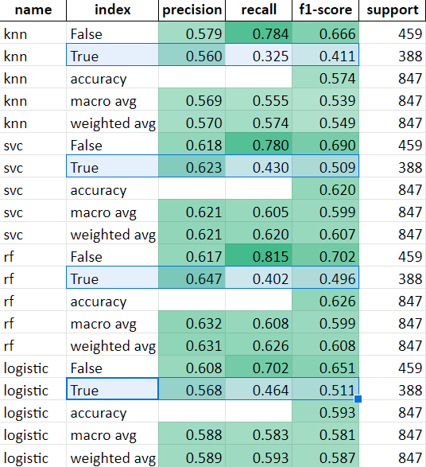
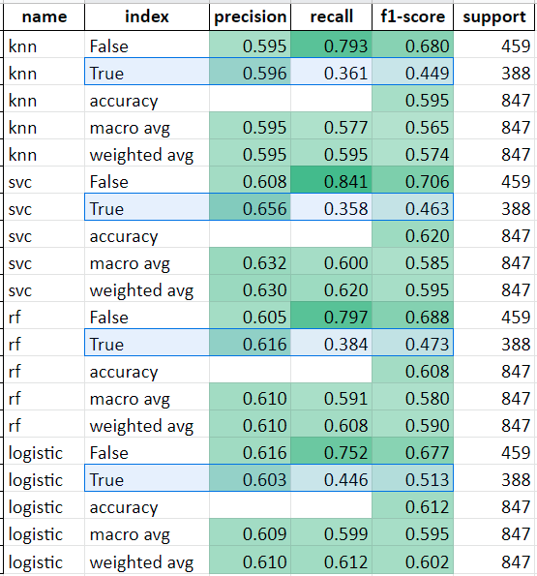
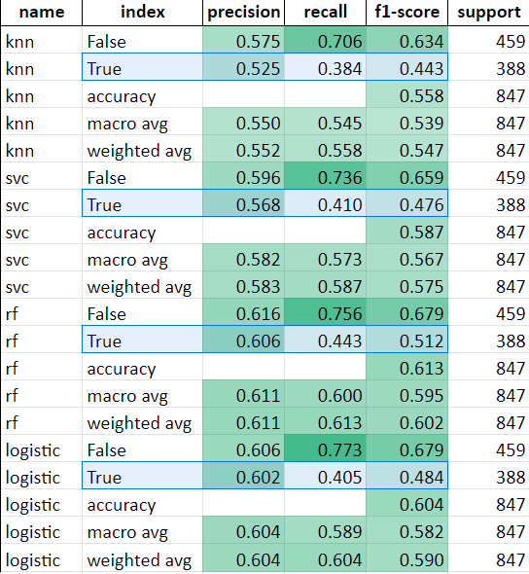
Rerunning baseline models with participants stratified
Baseline models
tsfresh feature selection
Collinear features removed (VIF<5)
Select k-best features (ANOVA f-classification score)
MSc Project • 2022.04.11 updates

Slide 28
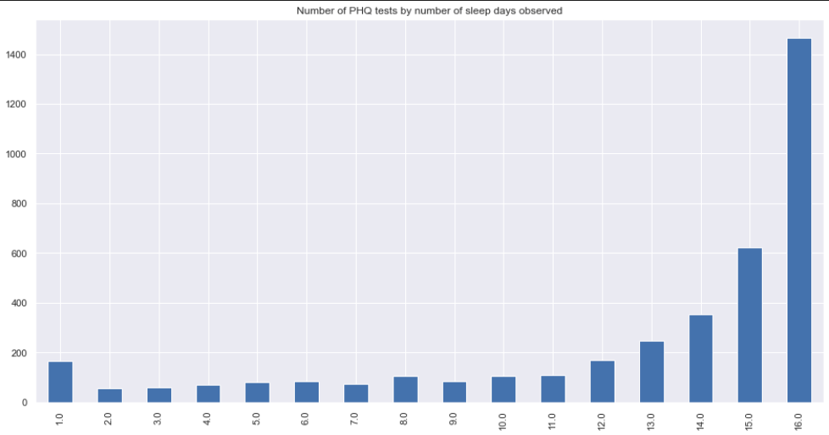
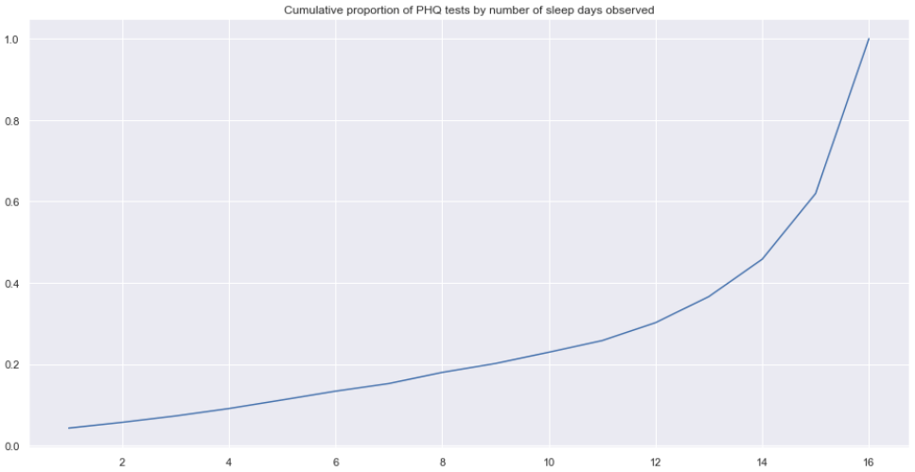
Is number of days observed associated with PHQ score?
EDA
MSc Project • 2022.04.11 updates

Slide 29
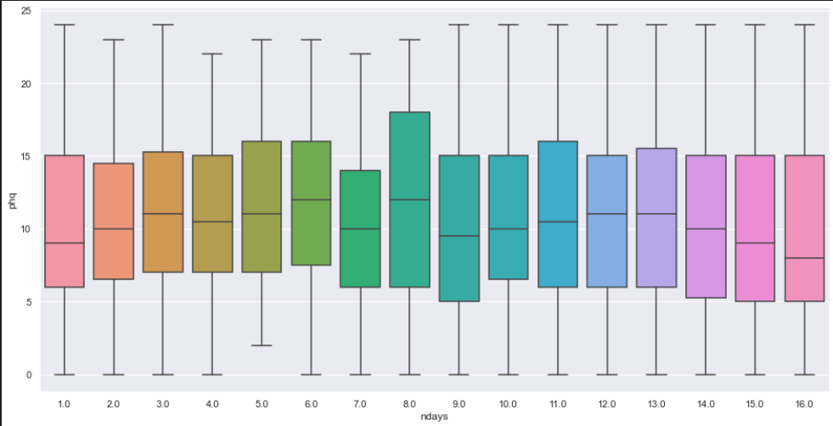
No association between number of days observed and PHQ score
EDA
MSc Project • 2022.04.11 updates

Slide 30

Nuances: (1) Sorting order (2) Number of nights included
Preprocessing
Nuances:
Maximum number of days observed = 16
Example:
PHQ date done on 22 Oct
Earliest sleep stage 7 Oct 00:01 (16 nights before)
Latest sleep stage 22 Oct 23:59 (data ‘leakage’ assuming PHQ test done before midnight)
16
15
14
15
14
8
3
7
2
2
1
1
MSc Project • 2022.04.11 updates

Slide 31
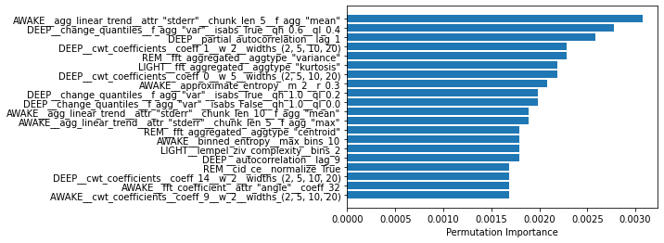
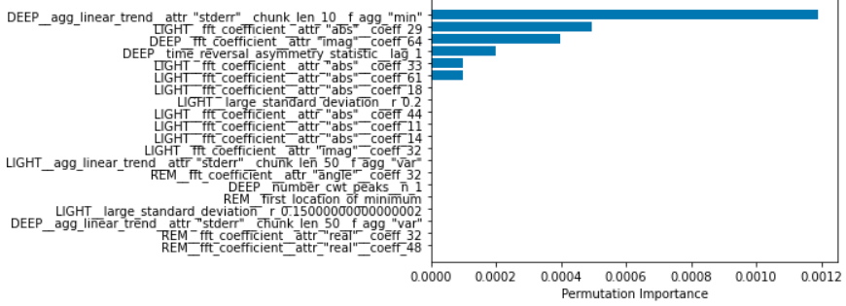
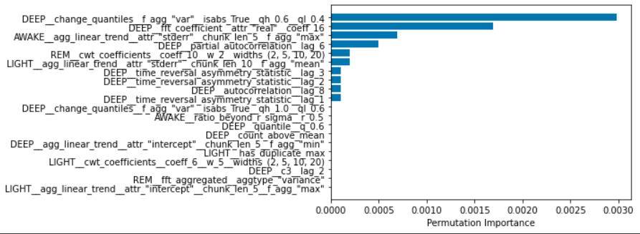
Feature importance from RF
Baseline models
MSc Project • 2022.04.11 updates

Slide 32
1am | 2am | 3am | 4am
>1 | 0
------------------- ======

Slide 33
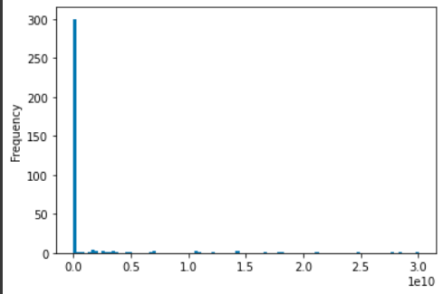
VIF on the train set
Feature selection
54/390 features with Infinite VIF
81/390 features with VIF<5
MSc Project • 2022.04.11 updates

Slide 34
Outline
Outline
Findings
Leakage in previous training
Discussions
Time-dynamic warping
Future directions
Feature selection with Recursive feature elimination
CNN on
Some questions:
What makes a good project?
Sleep stage time series [epoch=30s]
Binned time series [epoch=1h]
⤸ Feature extraction
Features
⤸ Feature selection
Selected features
⤸ Processing
Modelling
MSc Project • 2022.05.06 updates

Slide 35
Dynamic time warping
(1) Use KNN on binned time series, but use DTW as distance metric
(2) Employ DTW as feature extraction to derive metrics for assessing inter-night similarity
Sleep stage time series [epoch=30s]
Binned time series [epoch=1h]
⤸ Feature extraction by tsfresh
Features
⤸ Feature selection
Selected features
⤸ Processing
Modelling
MSc Project • 2022.05.06 updates

Slide 36
Feature selection
Sleep stage time series [epoch=30s]
Binned time series [epoch=1h]
⤸ Feature extraction
Features
⤸ Feature selection
Selected features
⤸ Processing
Modelling
MSc Project • 2022.05.06 updates

Slide 37
Outline
Outline
Unsupervised feature extraction by tsfresh
Baseline classifiers including xgboost, light-GBM
Performance
Experimentation with different bin size

Slide 38
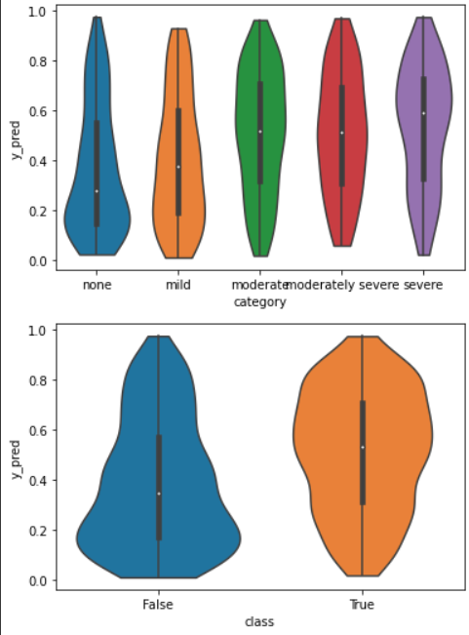
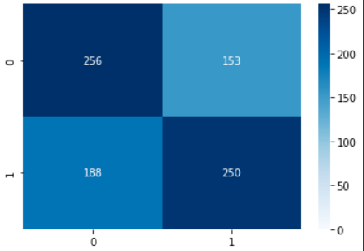
LightGBM on par with RF and xgboost
Unsupervised feature extraction by tsfresh
precision recall f1-score support
False 0.68 0.59 0.63 478
True 0.55 0.65 0.59 369
accuracy 0.61 847
From the violin plots, some information related to the depression severity is indeed captured
Not very strong discriminative ability
More robust towards multicollinearity
Left: LightBGM performance

Slide 39
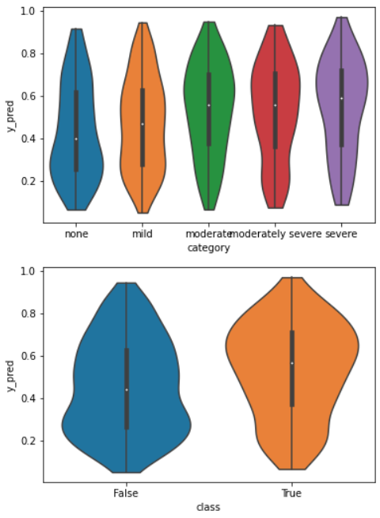
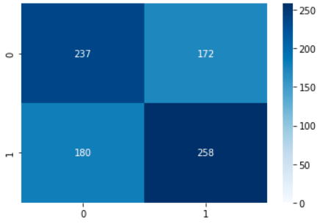
LightBGM performance rather unaffected after reducing to top 20 features
Unsupervised feature extraction by tsfresh
precision recall f1-score support
False 0.68 0.59 0.63 478
True 0.55 0.65 0.59 369
accuracy 0.61 847
precision recall f1-score support
False 0.58 0.57 0.57 417
True 0.59 0.60 0.59 430
accuracy 0.58 847
Left: LightBGM performance
Right: Performance after reducing to top 20 features
Features are ranked based on ‘p-values’
each feature vector is individually and independently evaluated with respect to its significance for predicting the target under investigation

Slide 40
Other classifiers after reducing to 15 features
Unsupervised feature extraction by tsfresh
all features 15 features
knn accuracy 0.574 0.6
svc accuracy 0.62 0.603
rf accuracy 0.626 0.62
logistic accuracy 0.593 0.609
lightbgm accuracy 0.61 0.58
each feature vector is individually and independently evaluated with respect to its significance for predicting the target under investigation

Slide 41
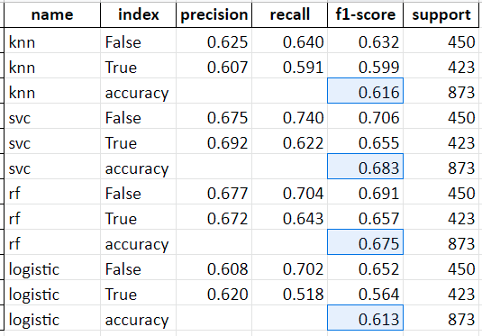
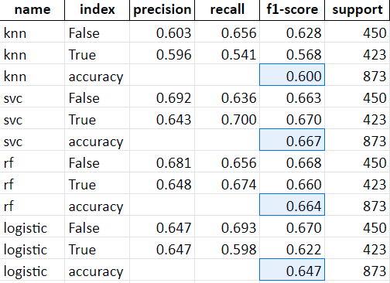
Experimenting with bin sizes – signif features???
1h 30m 15m

Slide 42

RF feature importance (bin size=30m)

Slide 43


RF feature importance (bin size=15m)

Slide 44



Slide 45
Experimental set-up
Feature generation
Previous work: unsupervised feature generation using tsfresh toolbox
Preprocessing involving binning into intervals, which give real number value time series
Tried 3 different bin sizes: 60m, 30m, 15m
New:
Extracted top 5 clinical features according to YueZhou’s paper
(also tried number of recorded/non-missing nights but not a significant feature)

Slide 46

Experimental set-up
Class distribution in joined dataset

Slide 47
Experimental set-up
Set-up:
‘Baseline’: 5 Clinical features only
Parameters:
(1) Additional features:
tsfresh with clinical features;
tsfresh without clinical features}
(2) tsfresh bin size:
15m-bin;
30m-bin;
60m-bin
(3) Feature selection:
all significant features (default behaviour)
top 50
top 30
top 15
(4) Classifier:
Support Vector Classifier
Random Forest

Slide 48



F1-score
SVC
baseline
1st
2nd
3rd
RF
baseline
1st
60m provides better performance than 30m and 15m
In each method, by comparing with or without clinical features, adding clinical features to tsfresh features improves performance
However, comparing to baseline, adding tsfresh features improves performance only in highest granularity (bin size = 60m)
The model can handle feature redundancy among top 50 features. Further selection (by p-value) does not further improve performance).

Slide 49


Accuracy
SVC
baseline
RF
baseline

Slide 50
Outline
Outline
Understanding results from last meeting
Feature collinearity
Cross validation optimized for another task
Updates
Feature engineering:
Including 7 more knowledge-driven features
Feature selection:
Correlation-based feature selection: WIP
PCA – how much information in the features?
Model validation:
Note on splitting and current set-up
Cross validation on PIDs
Side note: preprocessing
Non-missing nights cutoff

Slide 51
F1-score
RECAP
SVC
baseline
1st
2nd
3rd
RF
baseline
1st

Slide 52
Splitting routine
3 bin sizes; with/without clinical
…
All samples
Train test split, grouped by PIDs
Training
Test
Models (SVC/RF)
Tune hyperparameters
KFold Cross validation Grouping by PID

Slide 53

15m bin size + domain knowledge features
Feature sets are different across bin sizes (selected to top 15/30/50 by p-value)
Especially high collinearity in 15m top 50
The simple ‘select top P features’ is ineffective especially in 15m bin size
Need a better feature selection method

Slide 54

30m bin size + domain knowledge features

Slide 55

60m bin size + domain knowledge features

Slide 56

Feature overlap between bin sizes

Slide 57


PCA on tsfresh features
Rows:
15m
30m
60m
A benchmark to approximate how predictive the data is?
PCA on training set
Left: All PCs
Right: First 50 PCs
The correct conclusion should be the 15m feature set contains more collinear features

Slide 58



7 more clinical features
Statistics at night level
Features at deltaT level (After filtering non-missing nights >= 12 correlation matrix of Left: train set Right: complete set, +PHQ score)

Slide 59
Apparent & Internal Validation
SVC
5 clinical features
1st
2nd
3rd
RF
Features selected: 15m_signif: 426; 30m_signif: 398; 60m_signif: 408

Slide 60




Apparent & Internal Validation
SVC
5 clinical features
1st
2nd
3rd
RF
12 clinical features
SVC
RF

Slide 61




Apparent & Internal Validation
SVC
5 clinical features
1st
2nd
3rd
RF
12 clinical features
SVC
RF
SVC
12 clinical features + GroupedKFold
RF
Features selected: 15m_signif: 426; 30m_signif: 398; 60m_signif: 408

Slide 62

Class imbalance due to grouped train test split
Full dataset
Training set
Testing set

Slide 63



Side note: missing nights cutoff (current = 2 or less)
Missing non-missing nights nights
14 0
13 1
12 2
11 3
10 4
9 5
8 6
7 7
6 8
5 9
4 10
3 11
2 12
1 13
0 14
Sample size
Cumulative proportion
NON-MISSING nights

Slide 64
Next steps
Feature selection
Time series similarity
Does performance vary across patients? (e.g. significantly doing better in some patients?)

Slide 65
Outline
Outline
Next steps outlined in last meeting:
Feature selection → overfitting & establishing a sensible baseline
Does performance vary across patients? → overfitting & establishing a sensible baseline
Time series similarity → challenges faced
Updates
Looking at last meeting’s results…
Strong overfitting
Inter-night similarity – challenges

Slide 66
Last time’s results

Slide 67
SVC
12 clinical features + GroupedKFold
RF
Features selected: 15m_signif: 426; 30m_signif: 398; 60m_signif: 408

Slide 68

Increased min_sample_leaf search space to (1,2,3,4)
Best params:
{'rf__max_depth': 30, 'rf__max_features': 'sqrt', 'rf__min_samples_leaf': 1, 'rf__min_samples_split': 3, 'rf__n_estimators': 100}
New Search space {'rf__max_depth': [2, 5, 7, 10, 30, 50, None],
'rf__max_features': ('sqrt', None), 'rf__min_samples_leaf': (1, 2, 3, 4), 'rf__min_samples_split': (2, 3, 4, 5), 'rf__n_estimators': (100, 200)}
Will check with SVC and validate cross validation …
Training set: 226 patients; Testing: 97

Slide 69
Inter-night similarity -- challenges

Slide 70






Internight similarity -- challenges
Pulsatile signals, but its shape lack specificity + small #epochs (2-3)
Mining new patterns from data-driven approaches or otherwise?

Slide 71




Slide 72

PHQ score: 12 Sleep subscore: 3

Slide 73

Sleep disturbances: Main types according to literature
(1) Sleep continuity disturbances
Increased sleep latency
✅ Increased number of awakenings
✅ Increased WASO
Too early morning awakenings
✅ Shortened TST
✅ Reduced sleep efficiency
(2) Deep reduction
✅ Decreased deep sleep
Disturbed distribution of deep sleep (???)
Shift into the later cycle
Decreased ratio of deep sleep in 1st/2nd NREM periods
(3) REM disinhibition (believed to be more specific in depression)
🔎 Decreased REM latency — not significant
✅ Increased REM proportion, ‘strength’, ‘density’
Decreased mean latency (between REM period and first REM)

Slide 74
Cycle segmentation
Time series alone are not giving too much value

Slide 75


Slide 76


Instance 1
PHQ score: 12 (depressed) Sleep subscore: 3
Instance 2
PHQ score: 10 (depressed) Sleep subscore: 3
Instance 3
PHQ score: 3 (Non-depressed) Sleep subscore: 1

Slide 77



Period size:
60min
30min
15min
x-axis: Number of periods from midnight
Instance 1
PHQ score: 12 (depressed) Sleep subscore: 3

Slide 78



Period size:
60min
30min
15min
x-axis: Number of periods from midnight
Instance 2
PHQ score: 10 (depressed) Sleep subscore: 3

Slide 79



Period size:
60min
30min
15min
x-axis: Number of periods from midnight
Instance 3
PHQ score: 3 (non-depressed) Sleep subscore: 1

Slide 80
Other methods to represent sleep data?
Spectral analysis
Genomic sequence classification
Encoding strategies
Sequential encoding [0, .25, .5, .75, 1]
One-hot encoding
Kmer encoding
Sequence pattern mining
Haotian’s work
Preprocessing has been updated
Rerunning CNN and LSTM models with (i) more epochs (ii) different feature set
Transition times (4+1 stages -> 5P2=20 events)
“Intervals” into an LSTM
2D CNN with raw sequence (1680 epochs per night * 4 one-hot encoded stages* 14 nights)
Sample size may be limited (?) -> classify individual nights?
Yang, A., Zhang, W., Wang, J., Yang, K., Han, Y., & Zhang, L. (2020). Review on the application of machine learning algorithms in the sequence data mining of DNA. Frontiers in Bioengineering and Biotechnology, 8, 1032.

Slide 81

Light
Deep
Light
REM
Awake

Slide 83
Feature matrix 12 features x 14 nights
Night 1
Night 2
...
…
...
…
Night 14

Slide 84
Leakage …?
Subject/Participant
Night
Nights
…
Sleep stage time series [epoch=30s]
Binned time series [epoch=1h]
Feature extraction
Features
Feature selection
Selected features
Processing
Modelling
MSc Project • 2022.05.06 updates

Slide 85


Slide 86

Sleep stage binning routine is fixed
Preprocessing
Total non-missing proportions (hourly) now <1 with no exceptions
No fix
Last meeting
Now
MSc Project • 2022.03.24 updates

Slide 87


Binning routine is fixed
Preprocessing
As expected, completely empty hours are usually in midnight (total non-missing proportion = 0)
Before filling with zeros
Filling with zeros
MSc Project • 2022.03.24 updates

Slide 88
Binning routine is fixed
Preprocessing
Zeroes are mostly filled to
MSc Project • 2022.03.24 updates

Slide 89
Best hyperparameters
### knn
Best score: 0.6361371153306452
Best params: {'knn__n_neighbors': 9}
### svc
Best score: 0.644029916331013
Best params: {'svc__C': 10, 'svc__gamma': 0.001, 'svc__kernel': 'rbf'}
### rf
Best score: 0.6363237836379443
Best params: {'rf__max_depth': 20, 'rf__max_features': 'auto', 'rf__min_samples_split': 2, 'rf__n_estimators': 200}
### logistic
Best score: 0.6189314284232641
Best params: {'logistic__C': 0.1, 'logistic__penalty': 'l1', 'logistic__solver': 'liblinear'}

Slide 90


Slide 91

15m bin size + domain knowledge features

Slide 92

30m bin size + domain knowledge features

Slide 93

60m bin size + domain knowledge features

